Slide 1
XHTML

Slide 2
XHTML
XHTML is one of the many XML-based languages that have been defined
XHTML is, essentially, a “cleaned-up” version of HTML 4, reformulated using XML DTD technology
  there are three XHTML DTDs, corresponding to the three versions of HTML 4 (strict, transitional and frameset)
XHTML is designed to be compatible with XML-oriented user-agents
XHTML is also acceptable to HTML 4-oriented user agents
Therefore, Web developers who write their HTML documents to conform to XHTML will give a longer working-life to these documents

Slide 3
XHTML versus HTML
An XHTML document must be a well-formed XML document and must be valid according to one of the DTDs which define the three varieties of XHTML:
  the Strict DTD, which should be used when rendering is controlled by CSS
<!DOCTYPE html PUBLIC "-//W3C//DTD XHTML 1.0 Strict//EN"
"http://www.w3.org/TR/xhtml1/DTD/xhtml1-strict.dtd">
  the Transitional DTD, to be used for browsers that cannot handle CSS
<!DOCTYPE html PUBLIC "-//W3C//DTD XHTML 1.0Transitional//EN"
"http://www.w3.org/TR/xhtml1/DTD/xhtml1-transitional.dtd">
  the Frameset DTD, to be used when frames are used to divide up the browser window:
<!DOCTYPE html PUBLIC "-//W3C//DTD XHTML 1.0 Frameset//EN"
"http://www.w3.org/TR/xhtml1/DTD/xhtml1-frameset.dtd">

Slide 4
XHTML versus HTML
Since an XHTML document must be a well-formed XML document and must be valid according to one of the DTDs,
  an XHTML document must contain one root element
    (an XML well-formedness requirement)
  the root element must be delimited by <html> and </html> tags
    (a validity requirement, since html is defined as the root element in the XHTML DTDs)
  all XHTML tags and attributes must be in lower-case
    (a validity requirement, since the XHTML DTDs define the tags and attributes as lower-case and XML is case-sensitive)

Slide 5
XHTML versus HTML (contd.)
  a non-empty element must have start and closing tags, for example, every <p> tag must have a corresponding </p> tag and every <li> tag must have a corresponding </li> tag
    (a well-formedness requirement)
  the start tag for an empty element must have a final /, for example <img src=“some.jpg” />
    (a well-formedness requirement)
  elements must be properly nested
    (a well-formedness requirement)
  attribute values must be quoted
    (a well-formedness requirement)

Slide 6
XHTML versus HTML (contd.)
  attributes must have values
    (a well-formedness requirement)
    Ill-formed example:
      <input type=“checkbox” name="day" value="1" checked />
    Well-formed example:
      <input type=“checkbox” name="day" value="1" checked=“checked” />

Slide 7
XHTML versus HTML (contd.)
Since style-sheets and scripts are not XML, they must be escaped by placing them inside the special CDATA tags which XML provides for escaping non-XML text
Example style element
<style>
<![CDATA[
body {background-color:white;color:red}
h1 {background-color:orange;color:blue}
]]>
</style>
Example script element
<script language=“JavaScript” type=“text/javascript”>
<![CDATA[
alert(“Check-out the specimen exam paper”);
]]>
</script>

Slide 8
XHTML versus HTML (contd.)
Use the id attribute instead of the name attribute
  although the name attribute is still supported in XHTML 1.0, it is expected to be eliminated in future DTDs
One advantyage of adopting XHTML is that you can validate your documents, instead hoping that users who find them on the web will be able to view them. So use one of the following document type declarations
<!DOCTYPE html PUBLIC "-//W3C//DTD XHTML 1.0 Strict//EN"
"http://www.w3.org/TR/xhtml1/DTD/xhtml1-strict.dtd">
<!DOCTYPE html PUBLIC "-//W3C//DTD XHTML 1.0Transitional//EN"
"http://www.w3.org/TR/xhtml1/DTD/xhtml1-transitional.dtd">
<!DOCTYPE html PUBLIC "-//W3C//DTD XHTML 1.0 Frameset//EN"
"http://www.w3.org/TR/xhtml1/DTD/xhtml1-frameset.dtd">

Slide 9
Rendering XML documents

Slide 10
Rendering XML documents
Unlike HTML tags, no XML tag (other than XHTML tags) has any pre-defined rendering semantics
However, at least four rendering possibilities exist:
  some browsers, such as MSIE 5.5, are starting to introduce very simple default rendering semantics for arbitrary XML tags
  some browsers, including MSIE 5.5, accept CSS specifications for rendering XML tags
  the most powerful approaches involve using XSL (eXtensible Stylesheet Language), a very powerful language which enables arbitrary ways of rendering XML documents
    some browsers are starting to accept XSL stylesheets
    server-side software, driven by XSL stylesheets, can transform XML documents into HTML documents before serving them to browsers which cannot understand XML+XSL

Slide 11
Default Rendering Semantics
As said before, some browsers, such as MSIE 5.5, are starting to introduce very simple default rendering semantics for XML tags
MSIE 5.5 renders XML documents as interactively-expandable/contractable tree structures

Slide 12
Default Rendering Semantics (contd.)
Consider the XML specification below:
  <?xml version="1.0" ?>
  <!DOCTYPE people SYSTEM "personnel2.dtd">
  <people>
  <person>
  <female>Celia Larkin</female>
  </person>
  <person>
  <male>Bertie Ahern</male>
  </person>
  </people>
This is displayed by MISE 5.5 as shown on the next slide
Notice how the start tags of elements with element content, <people> and <person> tags have a - before them
  if we click on this -, MSIE will hide the children

Slide 13
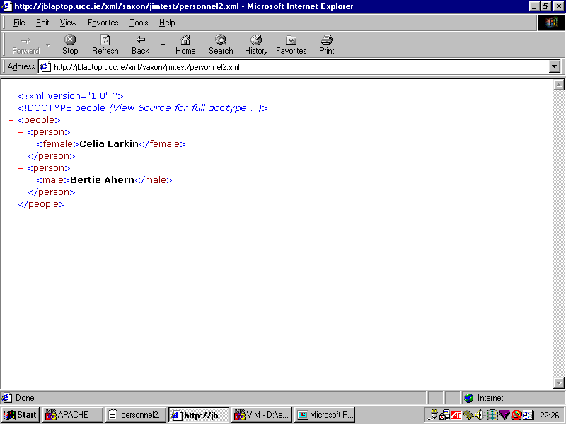

Slide 14
Default Rendering Semantics (contd.)
Say we click on the - before the <people> tag
MSIE will hide all the children of this element, as shown on the next slide
Notice, however that the - changes to a + which indicates that, if we click on it, MSIE will display the children again

Slide 15
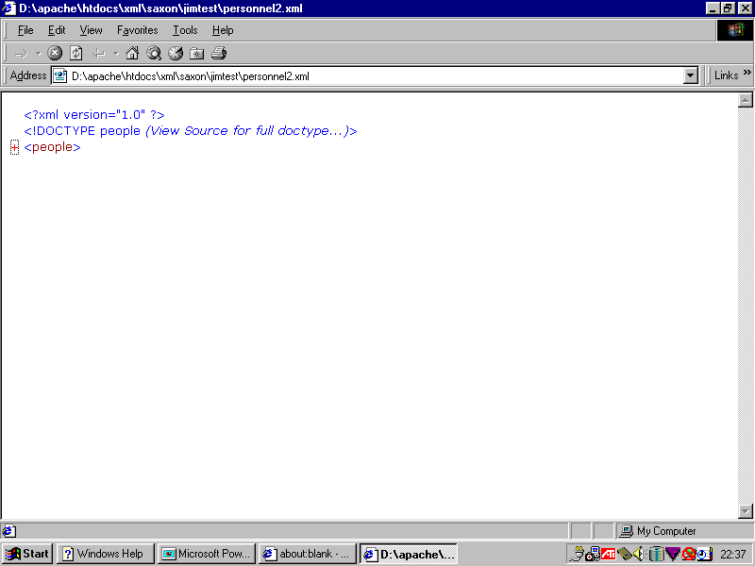

Slide 17
Default Rendering Semantics (contd.)
Say we click on the - before the first <person> tag
MSIE will hide the child of this element, as shown on the next slide
Notice, however that the - changes to a + which indicates that, if we click on it, MSIE will display the child again

Slide 18
